Slide 1
PREDICTIVE ANALYSIS ON 911 CALLS OF MONTOGOMERY COUNTY
Lakshmi Maligireddy, Data Engineer
Manojha Panneerselvam, Data Scientist

Slide 2
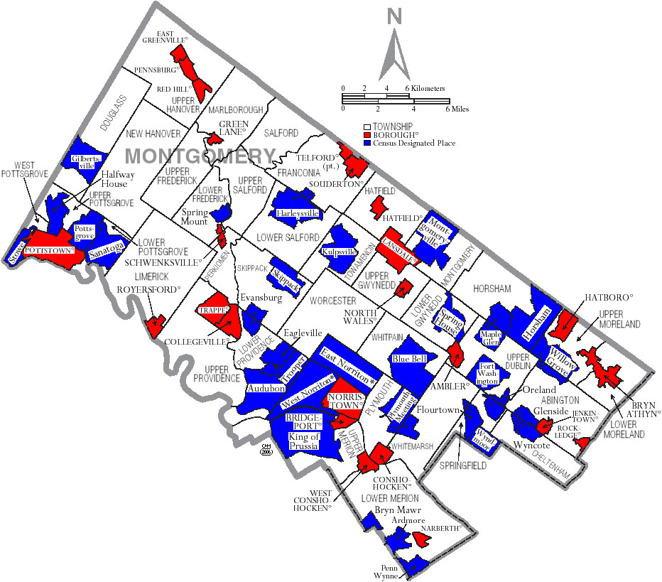
OBJECTIVE
Montgomery County is one of the populous Counties in The United States, so it is more prone to accidents, crime, and disaster. To help Montgomery police department serve their people better and keep their cities safe we decided to analyse the Montgomery 911 calls to find patterns and trends. Thereby, we ended up predicting the population density for each clusters and found a pattern for which portion requires more attention.

Slide 3
ROLES
DATA ENGINEER - Lakshmi Maligireddy
Data Acquisition
Data Cleaning
Data Exploration
DATA SCIENTIST - Manojha Panneerselvam
Statistical analysis
Model building
Visualization and identifying the patterns

Slide 4
TOOLS AND RESOURCES
Scripting Language: Python
Libraries used: Pandas, NumPy, matplotlib, seaborn, sklearn
IDE: PyCharm, Jupyter Notebooks
Visualization: Tableau
Project Management Tool: GitHub
Notes:
Pandas for database manipulation
Numpy for mathematical manipulation
Matplotlib and seaborn for plotting

Slide 5
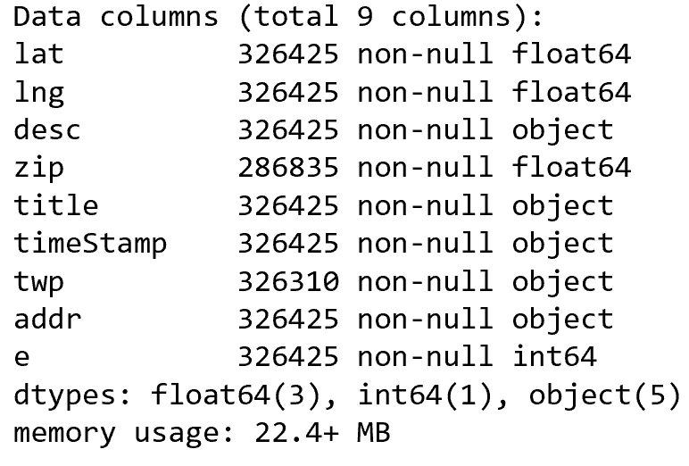
DATA ACQUISITION AND CLEANING
SOURCE: Kaggle
Mostly text data, few numerical data
Nine attributes
Data 2015 to 2018
Removed noisy data

Slide 6
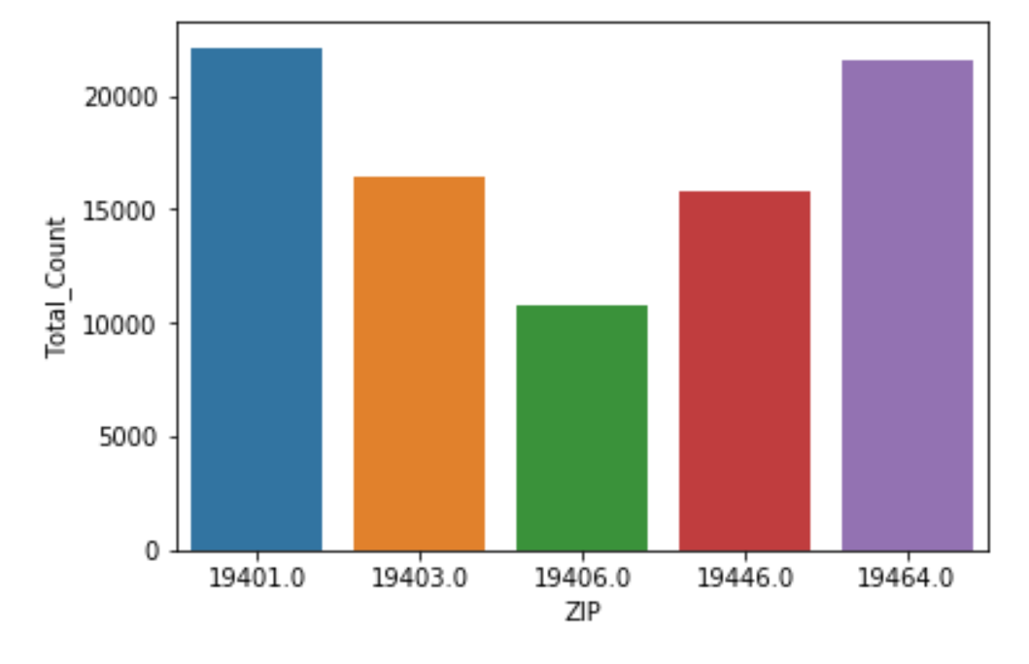
DATA EXPLORATION
TOP 5 ZIP CODES FOR 911 CALLS
Notes:
Now the dataset is ready for exploratory data analysis, we made some simple conclusions from the data

Slide 7
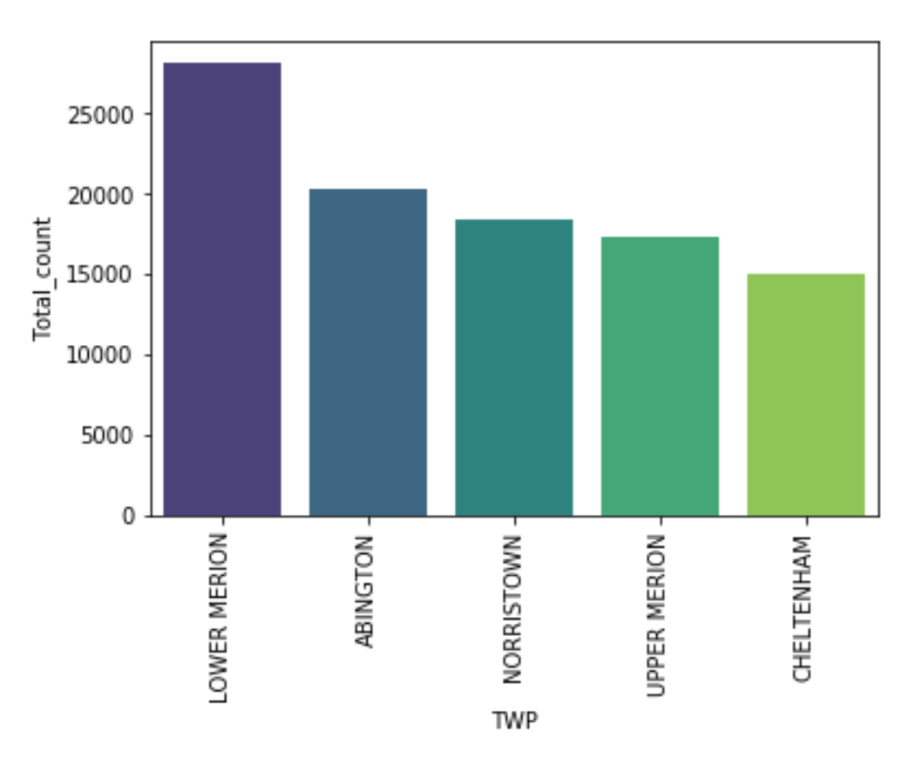
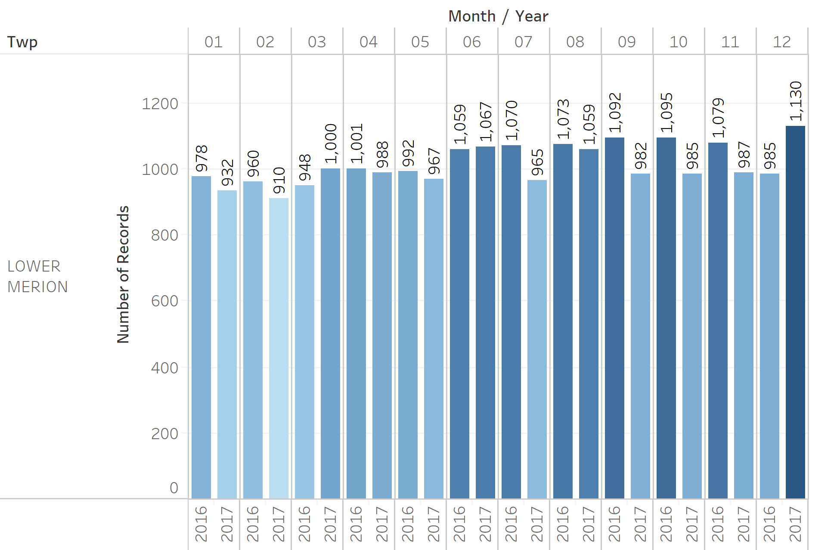
TOP 5 CITIES for 911 CALLS

Slide 8
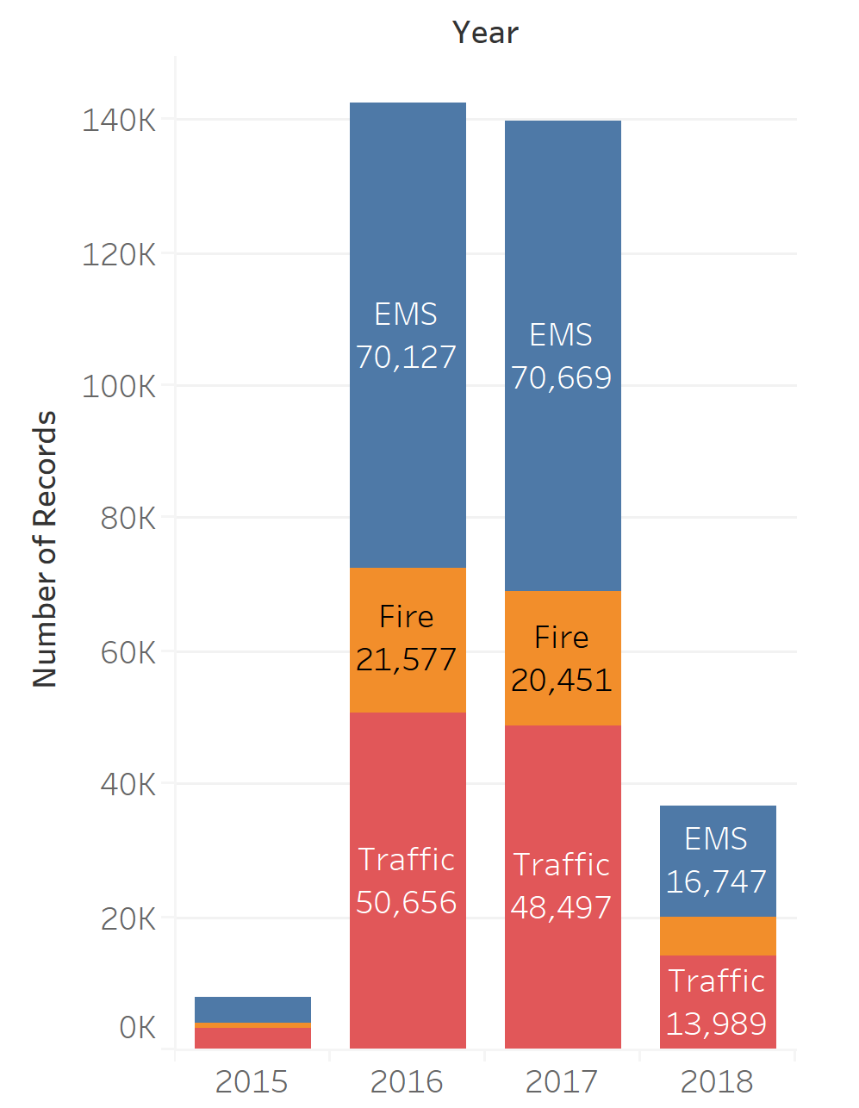
Notes:
Further extracting the several features from the attributes

Slide 9
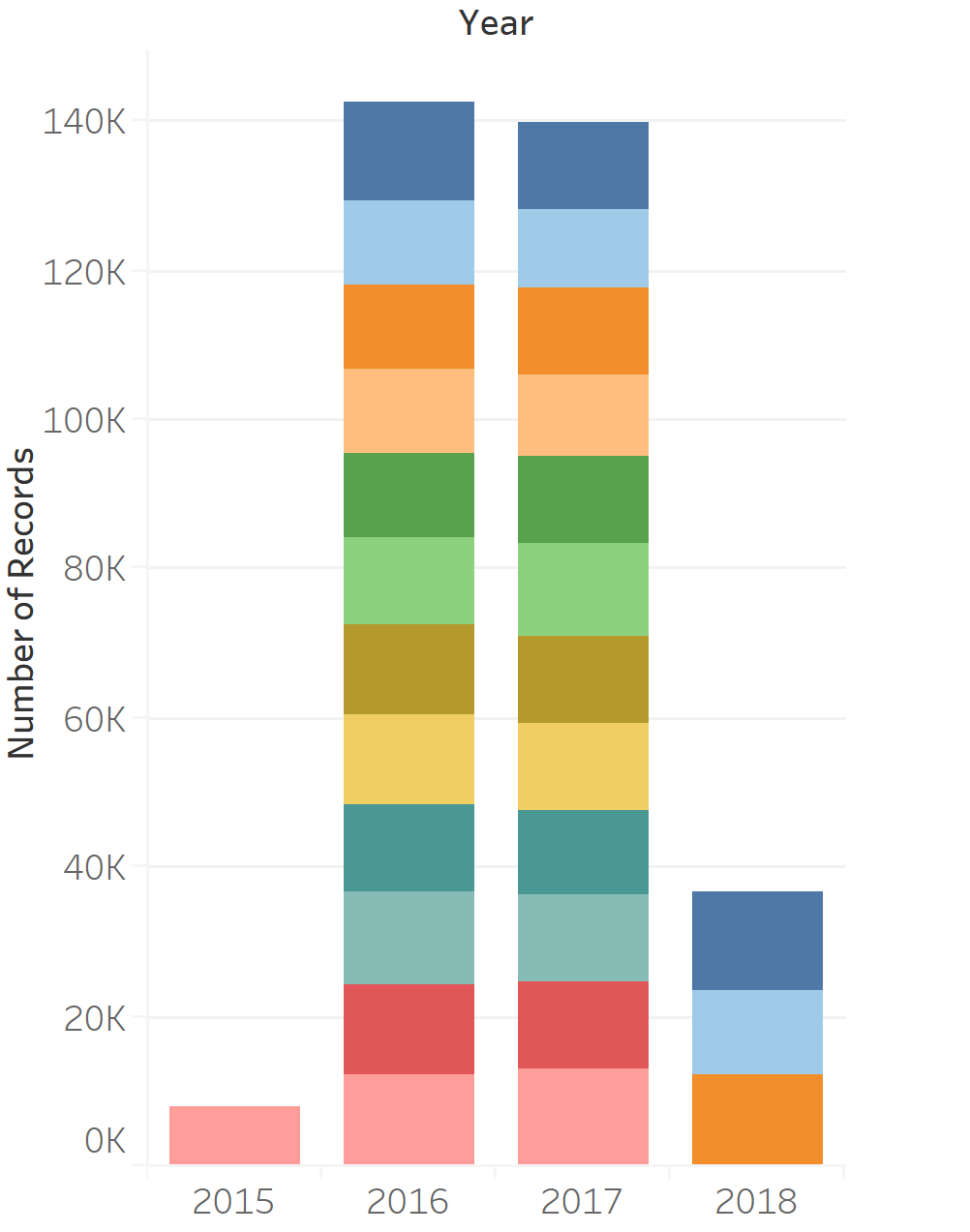
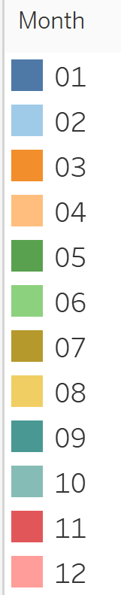

Slide 10
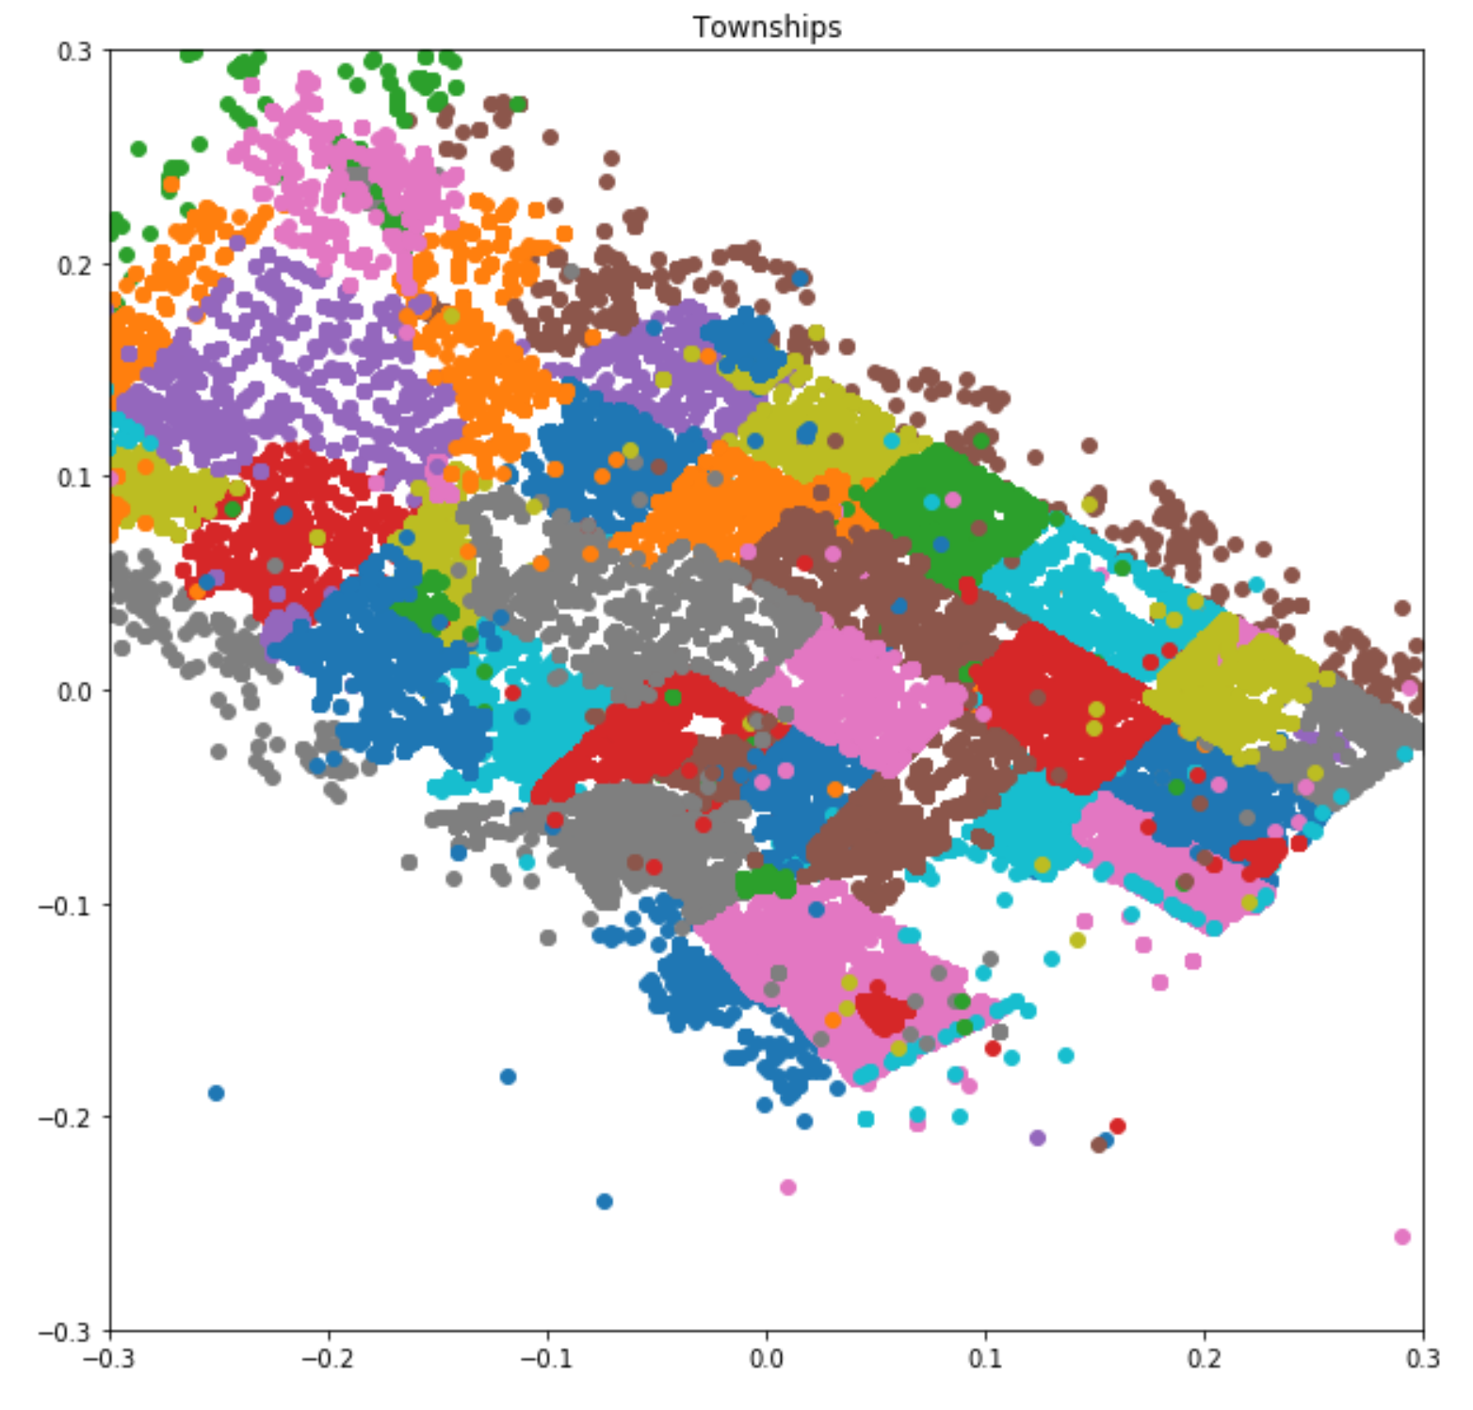
Notes:
trying to manage the emergency services for each township individually is inefficient. So a different grouping system arrangement is required.

Slide 11
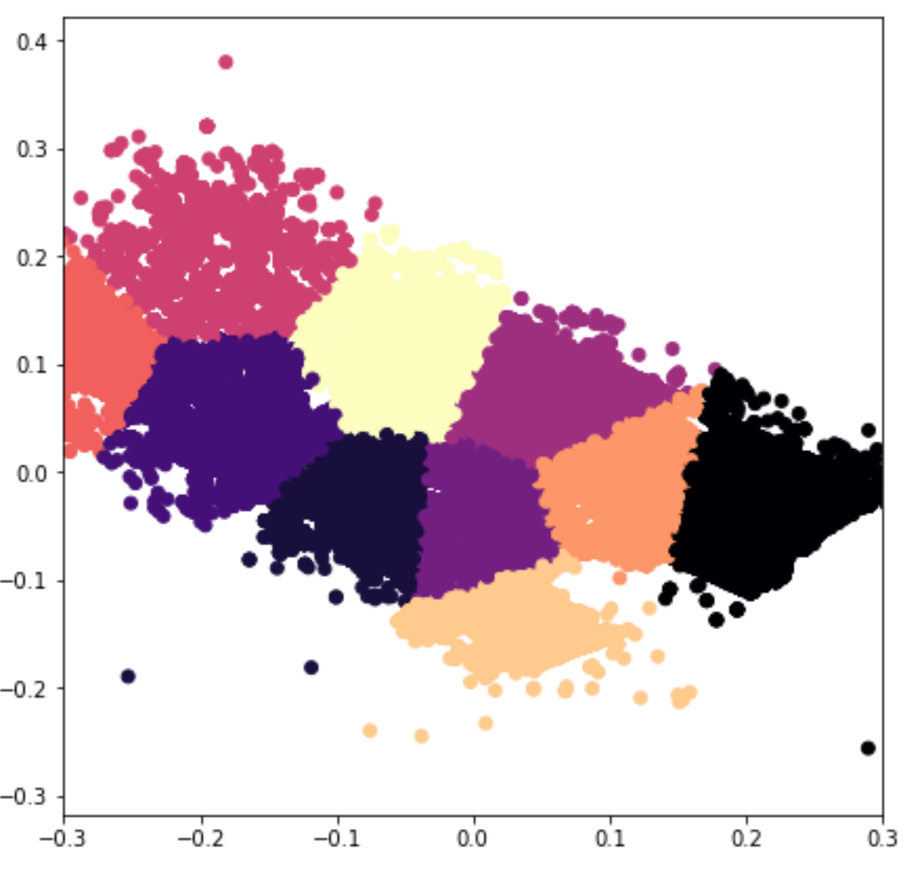
PREDICTIVE ANALYSIS UNSUPERVISED LEARNING, K-MEANS CLUSTERING
Notes:
Divided the township into clusters using basic K-Means Clustering by selecting number of clusters over a range

Slide 12
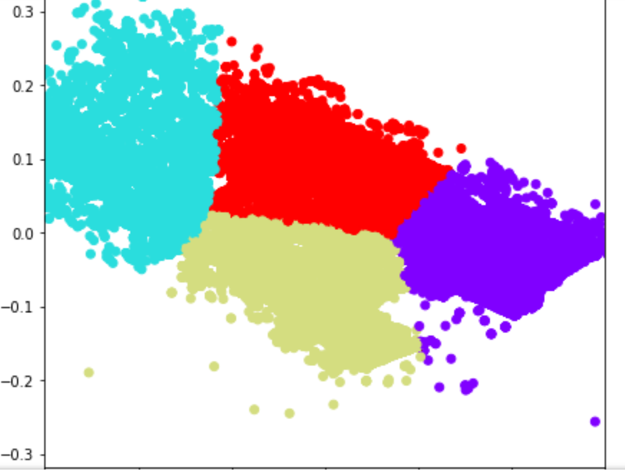
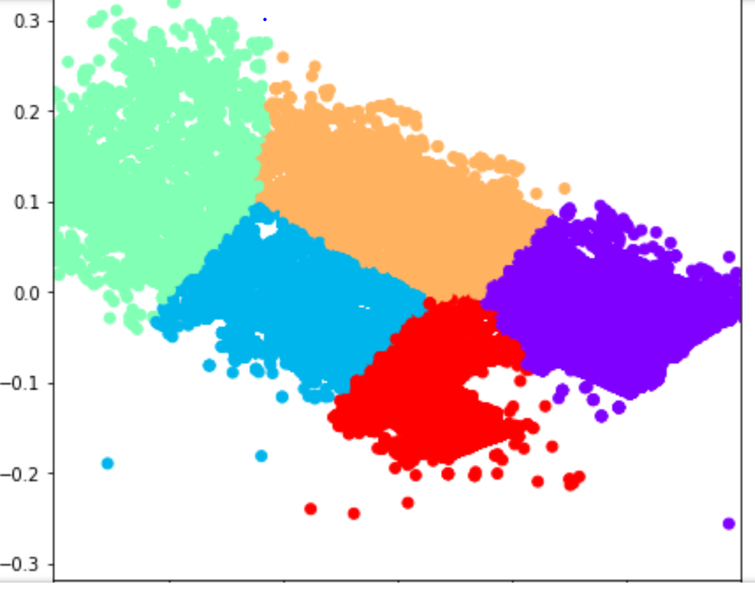
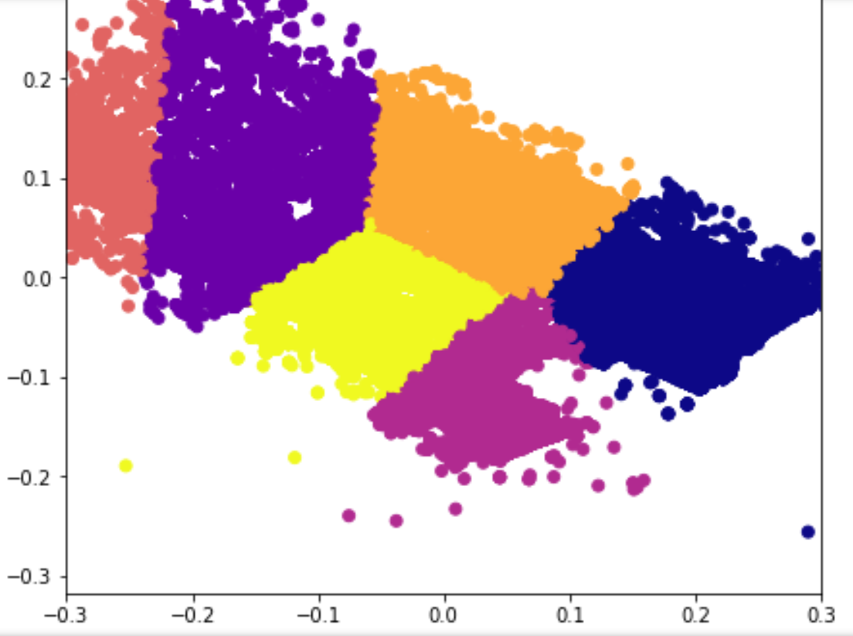
CLUSTER INFORMATION
Number of clusters = 4
Number of clusters = 5
Number of clusters = 6
Southern part suggests a lower population or a safer area, so we do not need multiple cluster, a single larger cluster is enough (like n_clusters=6).
Notes:
Southern part suggests a lower population or a safer area, so we do not need multiple cluster, a single larger cluster is enough (like n_clusters=6
The density is higher in the central part, which suggests the need of smaller clusters to accommodate a almost constant emergency services to population ratio, again here n_clusters=6

Slide 13
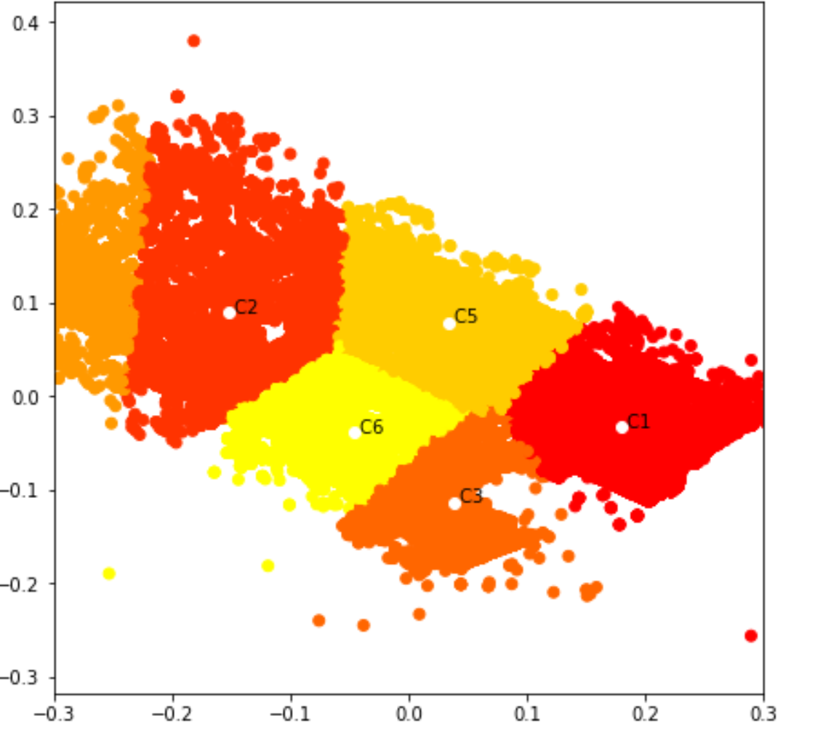
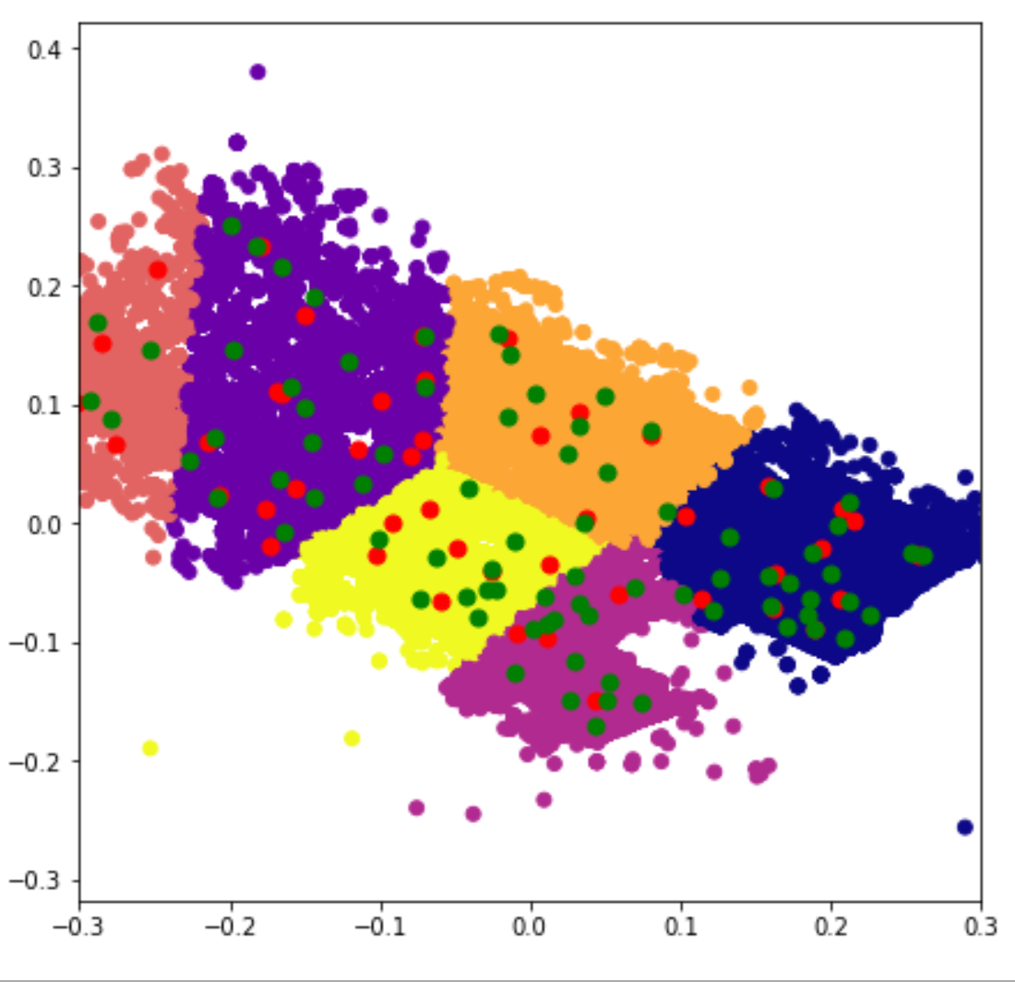
PREDICTED OUTCOME
APPROXIMATE CLUSTER AREAS | PREDICTED CLUSTER POPULATION
Cluster 4 : 1686.43 sq km | 453261.64
Cluster 1 : 928.28 sq km | 250699.9
Cluster 2 : 492.89 sq km | 64679.55
Cluster 6 : 461.72 sq km | 159927.08
Cluster 3 : 337.39 sq km | 102181.8
Cluster 5 : 296.78 sq km | 102194.55
The predicted population densities
C1-270.07, C2-334.11, C3-302.86, C4-268.77,
C5-344.34, C6-346.37
Per square km
EMS
FIRE

Slide 14
FLOW OF THE PROJECT
DATA ACQUISTION
DATA CLEANING
DATA EXPLORATION
MODEL THE DATA (IDENTIFIED THE HIDDEN INSIGHTS)
VISUALIZATION – Identifying the patterns
Notes:
We began with a simple detailed records of all emergency calls of a county. Firstly, we dealt with the features we did not need. Then we extracted whatever additional features we could from the given features. Then we used exploratory data analysis to find out some interesting aspects of the data including the emergencies per township.
Then we proceeded with the Geographical analysis of the data with the latitude and longitude aspects. We observed the maximum distribution of emergencies across a settlement and focused on it. The data suggests higher emergencies in certain areas over others, this suggests the presence of high risk populated zones which should be carefully managed.
To help in the above task we tried to find an efficient division of zones by clustering. We then evaluated our choice of number of clusters by evaluating the population densities calculated by the most accurate model.
Finally, by an analysis of the pre existing stations which not only proved the fact that the system in place is not extremely efficient and has a lot of room for intelligent improvement

Slide 15
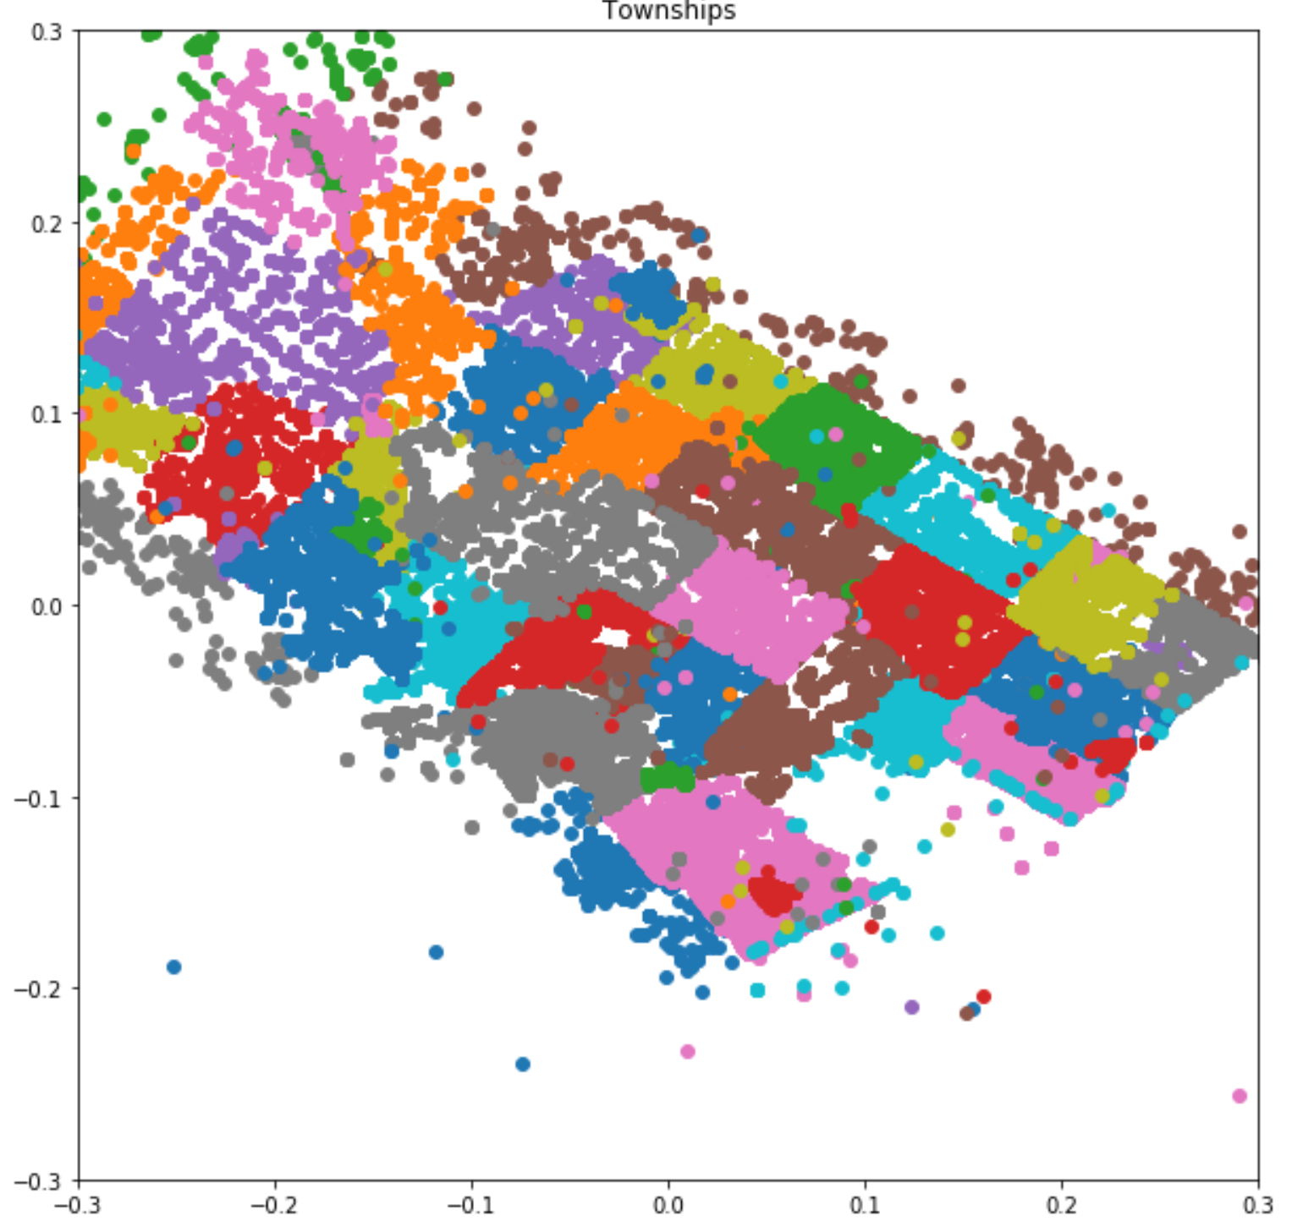
FUTURE WORK
This entire process can be repeated again for each individual district to build more sub-clusters each with better service handling capabilities. For this purpose we will require more data, preferably over a time period greater than 10 years. That way the increase in needs can also be considered as a factor

Slide 16
VALUE PROPOSITION
Public
Government
Police department
Intelligent Systems
Notes:
To serve the people better and keep the cities safe

Slide 17
SPRINTS
Data Acquisition, cleaning and exploring
Modeling
Visualization and identifying the patterns

Slide 18
THANK YOU

